Slide 1
Using Restricted Transactional Memory to Build a Scalable In-Memory Database
Zhaoguo Wang, Hao Qian, Jinyang Li, Haibo Chen

Slide 2
Outline
Background
Challenge
Design and Implementation - DBX
Shared in-memory store
Transactional layer
Evaluation

Slide 3
Background
High performance, correctly synchronized, scalable software
 | Performance | Complexity
Coarse-grained lock | Bad | NO
Fine-grained lock & Atomic operations | Good | YES

Slide 4
Background - RTM
Features:
RTM can perform more reads than writes
RTM prefers reads before writes

Slide 5
Background - RTM
Features:
RTM can perform more reads than writes
RTM prefers reads before writes
online transaction processing OLTP Workload

Slide 6
Target
A multicore in-memory database for online transaction processing (OLTP) workload
State-of-the-art in-memory database using fine-grained locking
Similar high performance
Scalability
Yet easier to implement and reason about correctness

Slide 7
Intuitive solution
Enclose each database transaction with a RTM region
RTMBegin()
…
Transaction Execution & Commit
…
RTMEnd()

Slide 8
Intuitive solution
Enclose each database transaction with a RTM region
RTMBegin()
…
Transaction Execution & Commit
…
RTMEnd()
RTM’s working set size too large
Overflow the hardware limits
Too much aborts
Notes:
Transaction working set:
Record, additional memory access

Slide 9
Challenge
Hardware limit -> limit spurious abort
RTM working set overflow
System events
Access conflict

Slide 10
Challenge
Hardware limit -> limit spurious abort
RTM working set overflow
System events
Access conflict
OCC to make critical RTM region size smaller
Cache-line aligned to avoid false conflict

Slide 11
Challenge
Hardware limit -> limit spurious abort
RTM working set overflow
System events
Access conflict
OCC to make critical RTM region size smaller
Cache-line aligned to avoid false conflict
Fallback Handler

Slide 12
Outline
Background
Challenge
Design and Implementation - DBX
Shared in-memory store
Transactional layer
Evaluation

Slide 13
Two Layer Design
Transactional Layer
Shared in-memory store
Transactional Layer
Transaction Execution & Commit
Shared in-memory store
Data store (B+ Tree, Hash Table)

Slide 14
Two Layer Design
Why adopting a two layer design?
Decoupling two layers, each can have smaller RTM region
RTM region used in one layer will not conflict the other
Transactional Layer
Shared in-memory store

Slide 15
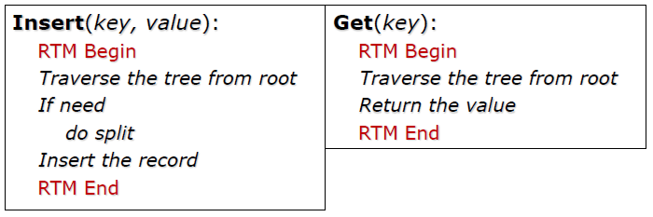
Shared in-memory store
B+ Tree: enclose each B+ tree operation with a coarse-grained RTM region
The graph adapted form CSDI 2018’
Notes:
It’s hard to implement a high performance B+ tree

Slide 16
Transaction Layer
OCC protocol
Transaction execution (record read write set)
Lock write set
Validation
Commit
Release locks

Slide 17
Transaction Layer
OCC protocol - example
Transaction
Read key1
Write key1
Read key2
Write key2
Write key3

Slide 18
Transaction Layer
Read Set
Key1 – seq 200
Key2 – seq 300
Write Set
Key1 – “new value1”
Key2 – “new value2”
Key3 – “new value3”
OCC protocol - example
Transaction
Read key1
Write key1
Read key2
Write key2
Write key3

Slide 19
Transaction Layer
Read Set
Key1 – seq 200
Key2 – seq 300
Write Set
Key1 – “new value1”
Key2 – “new value2”
Key3 – “new value3”
OCC protocol - example
Transaction
Read key1
Write key1
Read key2
Write key2
Write key3
Lock write set
Lock key1, key2, key3 (sorted)
Validation
Key1, key2 not modified by others (updated or removed)
Commit
Push key1, key2, key3 with new value, new seq num
Release Lock
Unlock key1, key2, key3

Slide 20
Transaction Layer
RTM protocol
Transaction execution (record read write set)
Lock write set -> RTMBegin
Validation
Commit
Release locks -> RTMEnd

Slide 21
Transaction Layer
RTM protocol
Read a record: pointer to record metadata, sequence number, add to read set
Modify a record: pointer to record metadata, new value, add to write set

Slide 22
RTM protocol
Transaction Execution
RTMBegin
Validation
Keys in read set not modified by others (updated or removed)
Commit
Push write set to database
RTMEnd

Slide 23
Discussion
Huge transactions are likely to be read-only in OLTP workload, do we have custom design for them?
To avoid unnecessary aborts
Notes:
Huge transactions -> bigger read / write set -> likely to abort

Slide 24
Read-only transactions
No validation phase - snapshot
No need to track information for validation, thus smaller RTM region size
New version and old version co-exist
Global Snapshot Number
n
Record
Local snapshot number
Record info (key val seq)
Old versions
Old version
Old version
Notes:
Huge transactions -> bigger read / write set -> likely to abort
Fixed-size RTM region

Slide 25
Read-only transactions
Read-only transaction update Global Snapshot Number (5 -> 6)
Local snapshot number (lsn)
Read-only Transaction
Global Snapshot Number
5 -> 6
Record 1
Record 2
Version
lsn 5
Notes:
Huge transactions -> bigger read / write set -> likely to abort
Fixed-size RTM region

Slide 26
Read-only transactions
Read-only transaction update Global Snapshot Number (5 -> 6)
Local snapshot number (lsn)
Read-only Transaction
Global Snapshot Number
5 -> 6
Record 1
Record 2
Check record’s lsn == Global Snapshot Number
Version
lsn 5
Version
lsn 6
Read-write Transaction
Notes:
Huge transactions -> bigger read / write set -> likely to abort
Fixed-size RTM region

Slide 27
Read-only transactions
Read-only transaction update Global Snapshot Number (5 -> 6)
Local snapshot number (lsn)
Read-only Transaction
Global Snapshot Number
5 -> 6
Read the versions with local snapshot number < 6
Record 1
Record 2
Check record’s lsn == Global Snapshot Number
Version
lsn 5
Version
lsn 6
Read-write Transaction
Notes:
Huge transactions -> bigger read / write set -> likely to abort
Fixed-size RTM region

Slide 28
Garbage Collection
Old record (delete)
Old version (update)
Grace Period
Interval of time during which all threads have finished at least one transaction
A point to a old record (or version) will not be needed after a grace period

Slide 29
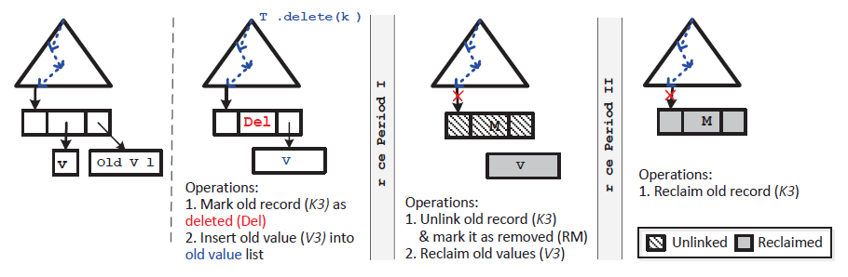
Garbage Collection
Period 1: read-only transactions to read old versions

Slide 30
Garbage Collection
Period 1: read-only transactions to read old versions
Period 2: no other transactions holds the pointer to old record

Slide 31
Evaluation Setup
Intel Haswell i7-4770 processor
A single chip with 4 cores/8 hardware threads
Each core
Private 32KB L1 cache
Private 256KB L2 cache
Shared 8MB L3 cache

Slide 32
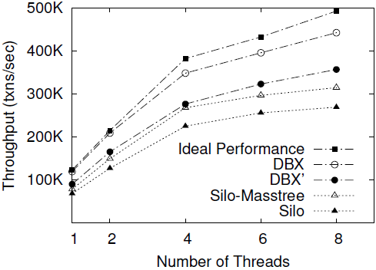
TPC-C (OLTP benchmark)
Masstree & DBX’:
Encode tree node into byte stream
Allocate memory for get & put operations
Locking overhead:
Sort locks to avoid deadlock
Atomic instruction & memory barriers
Ideal Performance:
RTM overhead
No correctness guarantee
Notes:
Masstree: a state-of-art trie-structured tree highly tuned for multicore

Slide 33
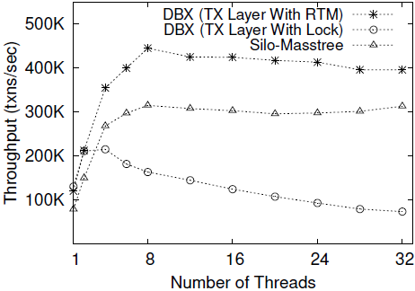
Scalability
TPC-C benchmark
TX Layer with lock:
Spinlock
TX Layer with RTM:
Slowdown 10% from 8 to 32
RTM aborts
Silo-Masstree:
No performance slowdown

Slide 34

Thanks!
Notes:
先读后写，读多写少的硬件特性
通过使用硬件事务内存，避免并发事务在验证阶段不必要竞争，在此基础上构建了高可扩展事务处理系统DBX

Slide 35
--------------------Backup Slides----------------------

Slide 36
Discussion
How to detect conflict between reading a non-existing key and an insert?
Read
Insert
Non-existing key
New record

Slide 37
Discussion
When reading a non-existing record, we insert the pointer to a new allocated empty record with sequence number 0 and track it in read set.
Read
Insert
Insert
Conflict!
Empty record
New record

Slide 38
Read-only transactions
Read-only transaction can read the most-recent snapshot
New snapshots are created only when needed
Need garbage collection for old versions

Slide 39
Fallback Handler
RTM does not guarantee progress
Turn to lock protection when the abort number reaches a threshold
When using RTM for lock elision, fallback handler should be tuned according to workload *
a global lock will abort any concurrent transactions and may incur heavy contention
The abort reasons will effect the fallback policy
* quote from Wang, Z., Qian, H., Chen, H., & Li, J. (2013, July). Opportunities and pitfalls of multi-core scaling using hardware transaction memory. In Proceedings of the 4th Asia-Pacific Workshop on Systems (p. 3). ACM.

